Slide 1
Predicting West Nile Virus Rates in Chicago
Final Presentation:
A Capstone Element for Springboard’s Data Science Program
Evan Meeks
November 12, 2022

Slide 2
Curbing the Outbreak
How can the City of Chicago treat and proactively prevent West Nile Virus outbreaks around the city?
Can a model be built to predict future outbreak times and locations?

Slide 3
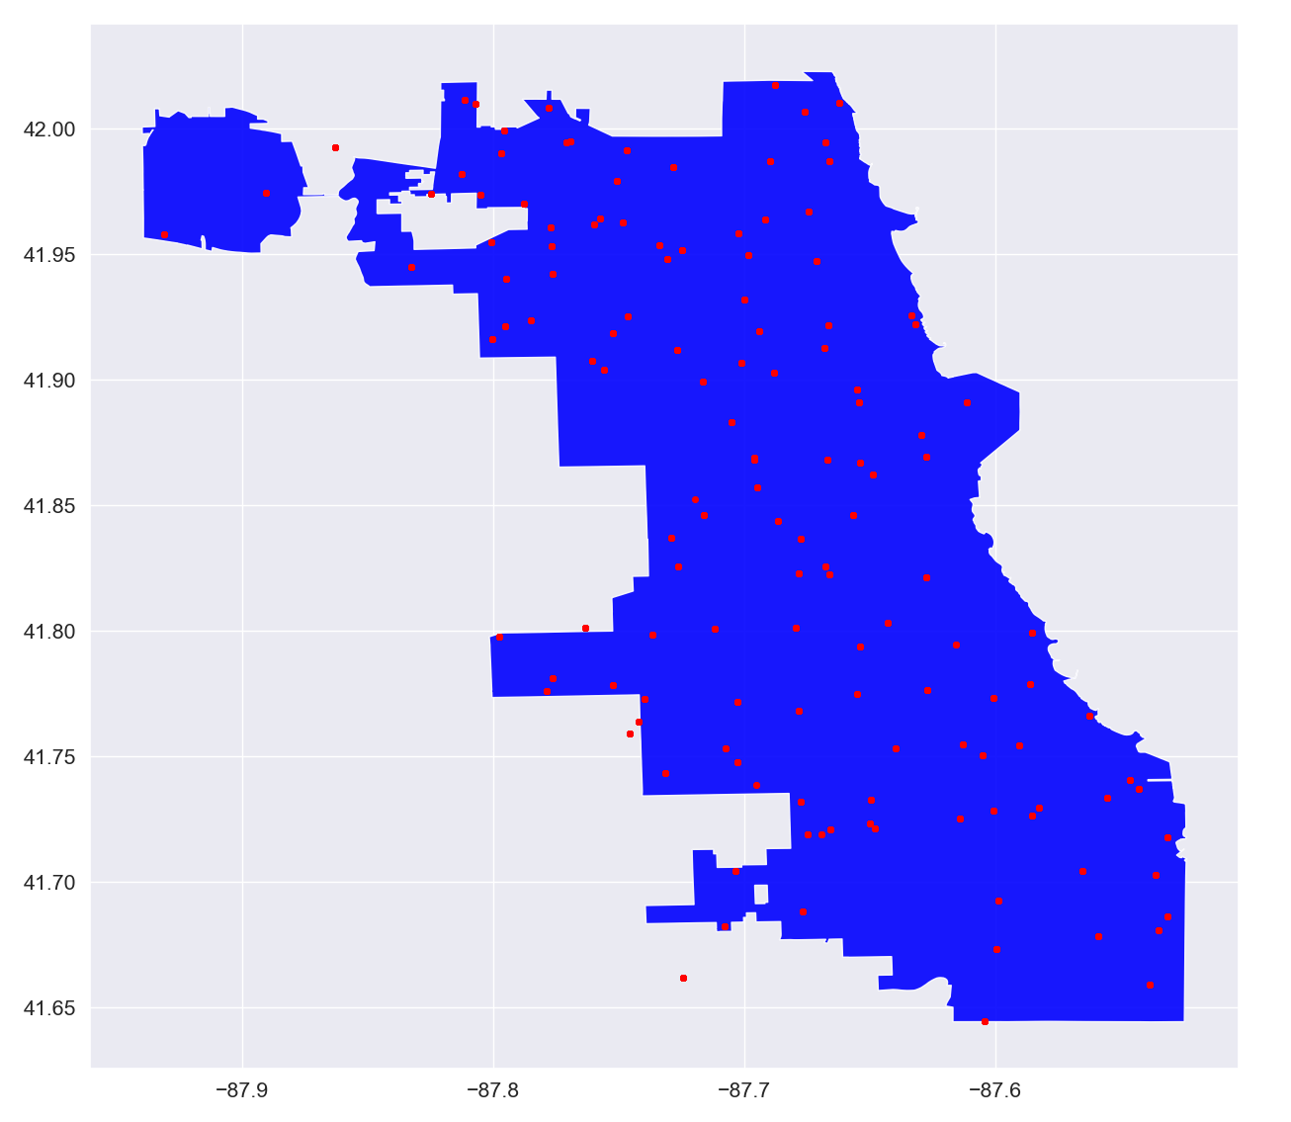
Historical Location Data

Slide 4
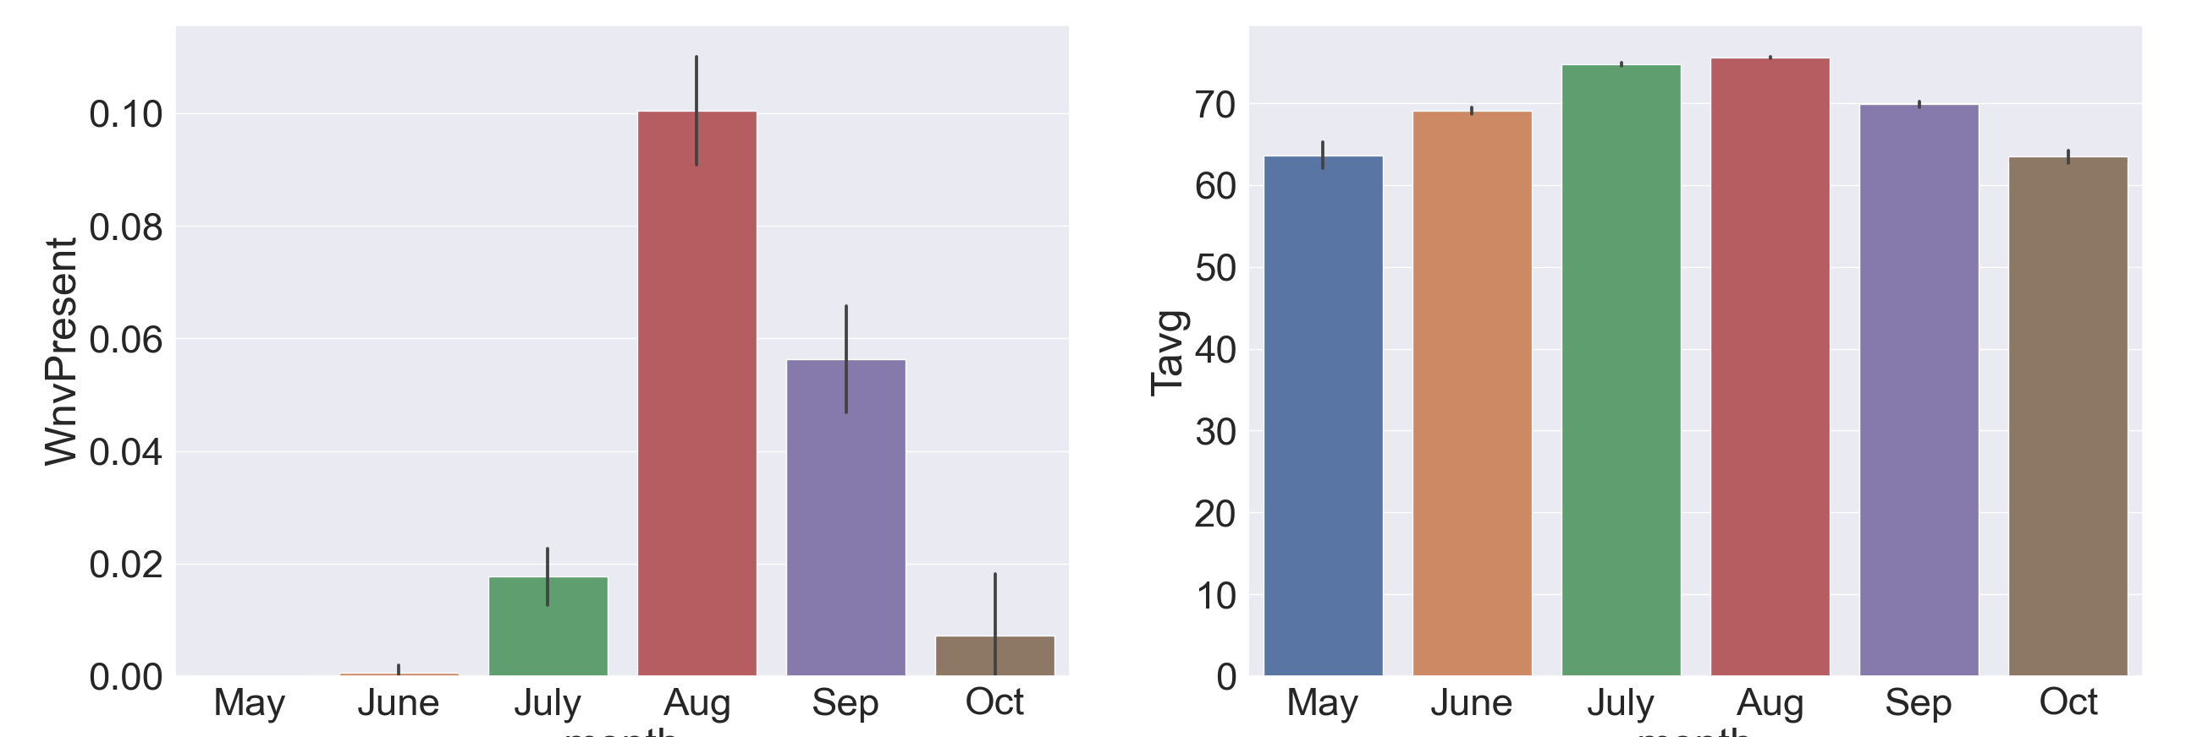
Average Monthly Temperature and Virus Case Count

Slide 5
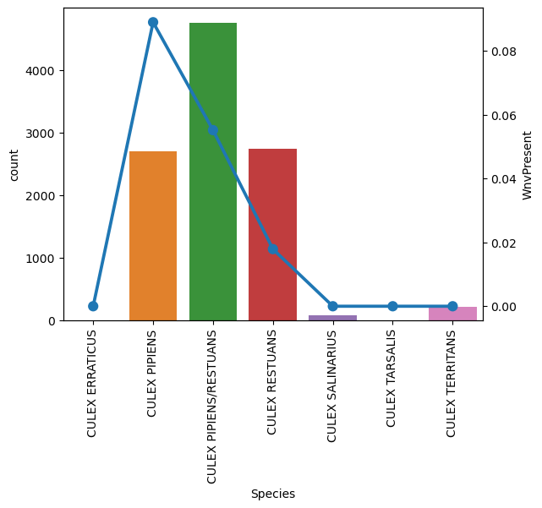
Case Rate
by Mosquito Species

Slide 6
Top 10 IV Scores
Variable | WOE Score | IV Score
month_June | 0.169814 | 0.722502
month_June | -4.46474 | 0.722502
month_Aug | 0.702486 | 0.497652
month_Aug | -0.73879 | 0.497652
year_2009 | 0.218522 | 0.396059
year_2009 | -1.87122 | 0.396059
Species_CULEX RESTUANS | -1.11175 | 0.241927
Species_CULEX RESTUANS | 0.22201 | 0.241927
month_July | 0.210094 | 0.231874
month_July | -1.12503 | 0.231874

Slide 7
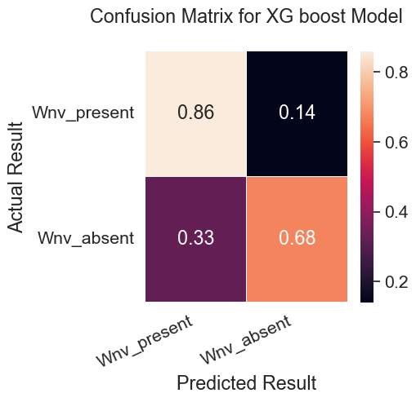
Tested Algorithms
Model | AUC Score
Linear Regression | 0.50
Random Forest Classifier | 0.57
XGBoost | 0.77

Slide 8
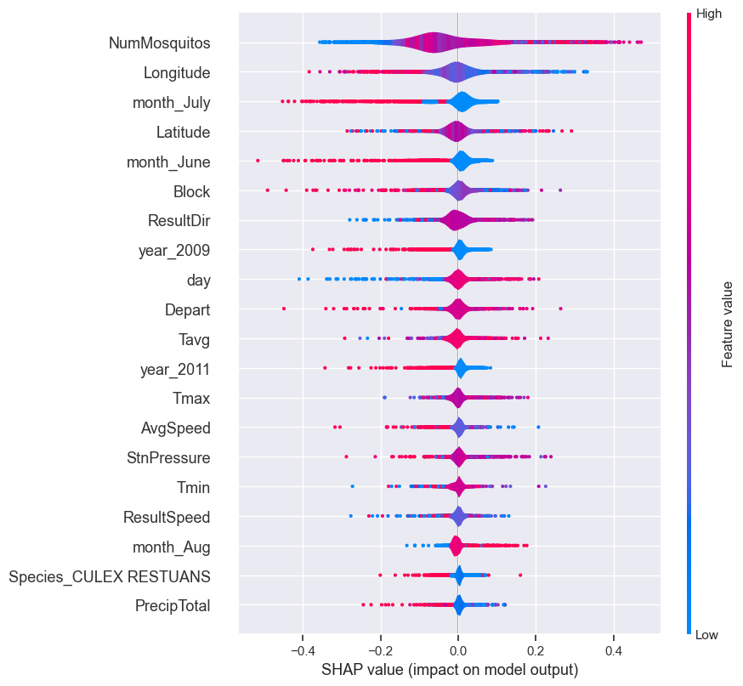
XGBoost Breakdown

Slide 9
Key Points
The sheer quantity of mosquitos was the largest indicator for WNV
The 40 through 80 blocks of Chicago experienced the highest case count
Higher wind speeds and winds towards the lake resulted in lower case counts
Cullex Pipens and Cullex Restauns were the only infected species

Slide 10
Next Steps
Consider increased monitoring between the 40 and 80 blocks of Chicago as these saw the highest rates in the most recent year of data available.
devote most of your resources to between June and July to kill off the mosquito population and prevent reproduction.
Expect higher mosquito counts during times of low wind or in areas protected from it.

